Slide 1
ActivityTools for Microsoft Dynamics 365 & Power Apps
www.mscrm-addons.com

Slide 2
Simple E-mail & Activity Handling in Dynamics 365 & Power Apps
Get an Outlook look & feel experience when dealing with activities in Dynamics 365
ACTIVITY HANDLING
360° view on all related activities
Outlook look & feel with list & preview pane
Load on demand to ensure performance!
Advanced search and filter capabilities
CUSTOMIZATION
Embed into any Dynamics form (Standard and custom entities)
Fully customizable layout for previews
Support for standard & custom activities
Integration in social pane possible
Notes:
Another business problem we are providing a solution for is: Tracking of phone calls. One huge value of a CRM system is that all customer interaction is stored and can be reviewed in order to decide whats best next.
Unfortunately its quite a lot of clicks to e.g. Store a phone call (create, enter data, lookup contact/lead, regarding etc. )
Dialing: provide a simple methdo of initiating phone calls with contacts.
Power-dialing – telemarketing/inside sales teams etc.
So we aim to rpovide a single interface to many phone systems. On the right you can see some of the supported vendors. (old fashioned systems but, likewise to the market, we are seeing more demand for support of VOIP based systems like Skype for business or Ringcentral)

Slide 3
Key Features
ACTIVITY & E-MAIL PREVIEW
CUSTOM ACTIVITIES
FORM DESIGNER
See all your activities, e-Mails & tasks at one glance in a 360° view, like what you already know from MS Outlook.
The view is fully customizable and can be tailored specifically to your requirements.
The easy-to-use Form Designer gives you a vast array of options to configure each activity type's preview.
SEARCH & FILTER OPTIONS
EASY DEPLOYMENT
PERFORMANCE OPTIMIZATION
Different options for searching and filtering like Quick Search, Content Search, or Data Range Search ensure that you will find exactly what you are looking for.
Activity Preview can simply be embedded into entity forms as a web resource. Standard, as well as custom entities, are supported.
ActivityTools only loads records and related data on-demand. This ensures faster loading times regardless of size and number of activities.
And many more…
Notes:
A lot of document s- it has to be simple. – non manual
Donations, PowerApps Portal integrations

Slide 4
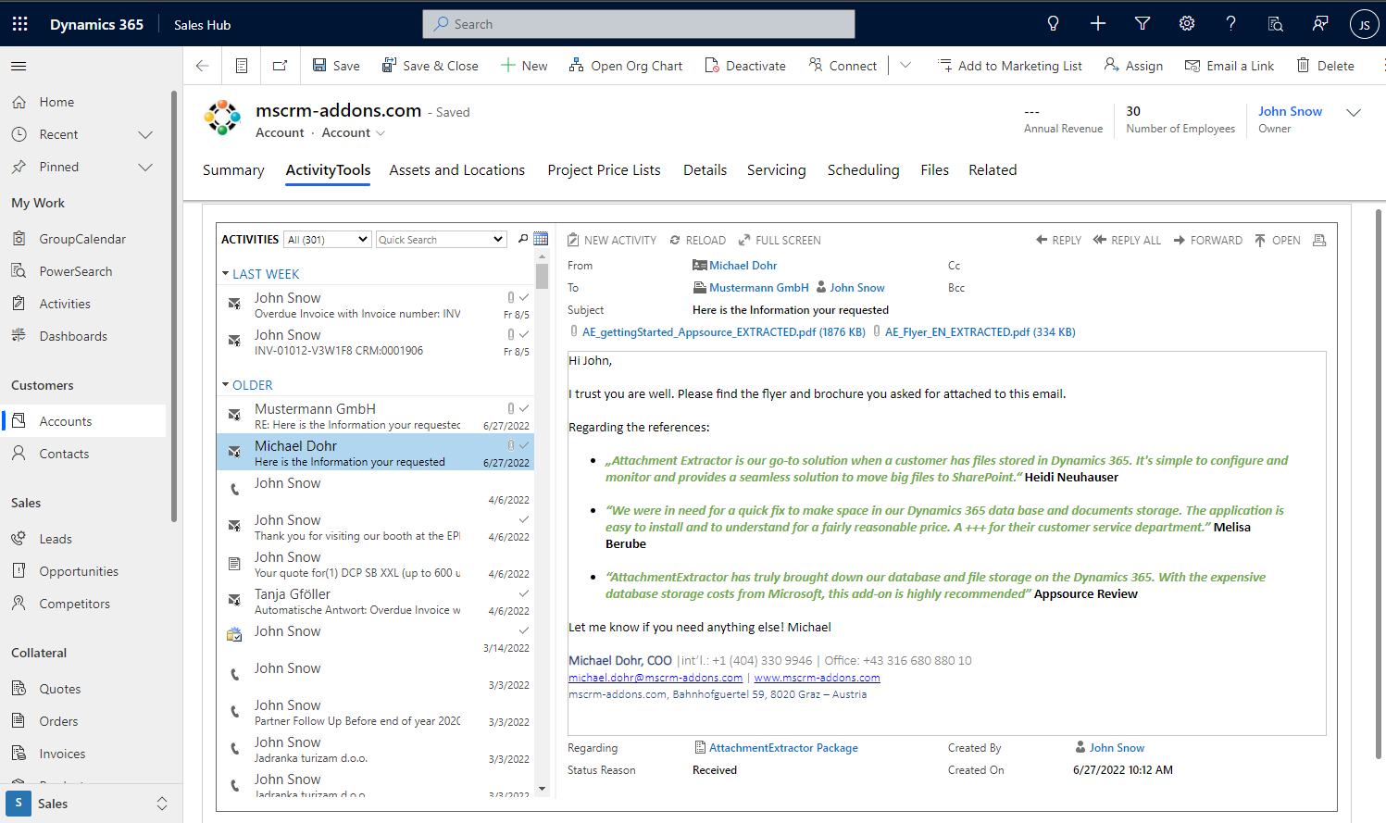
Outlook-like Activity Handling in Dynamics 365 & PowerApps
Visualization
360° view of all related activities
Outlook-like access to activities with a minimum # of clicks
High performance to handle large datasets
Advanced search and filter capabilities
Customizable content
List view: Search Sort
Preview: Customizable content Access to attachments
Notes:
Company overview - ~1 min
- Locations (+US) – better support service
Gold partner + certified solutions
Speaker: 1 sentence –

Slide 5
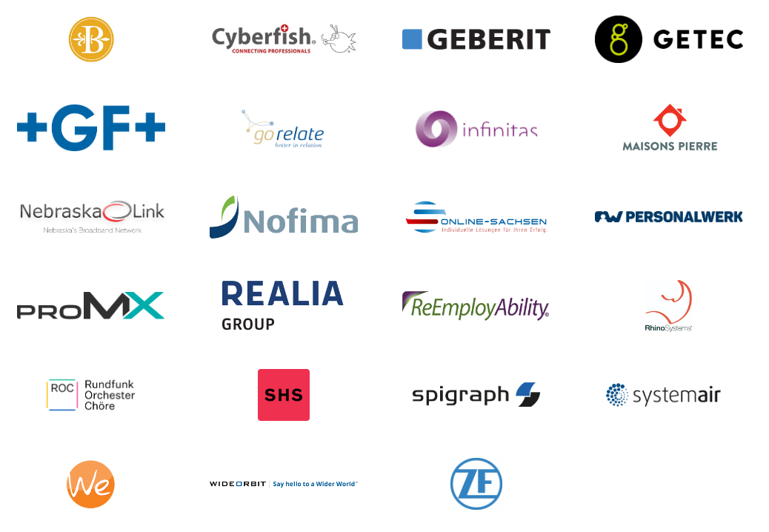
Customer Statistics and Benchmarks
Active customers: 150+
SMB to Enterprise
Highest # of users: 2900
Success Stories

Slide 6
Free Trial
Free Trials Available for all Add-Ons
No functional limitations
Fully supported
~30 minutes to get started

Slide 7
Getting Started
Download and Install ActivityTools Download: AppSource Find AppSource installation steps here
Info: https://www.mscrm-addons.com/Products/ActivityTools
That’s it! Our solution will run in trial mode for 14 days automatically If you need an extension, simply contact your Partner Manager or our support team and ask for keys!
All trials are fully supported. Don’t hesitate to contact our Support Team should you have any questions!
- Live-Chat (available 17 hours a day)
- E-mail to support@mscrm-addons.com
Note: for On-Premise Deployments see: Download Area

Slide 8
Pricing EUR
License Model: Subscription
Support & Maintenance is included
Component | Price /license monthly /annually | Support & Maintenance
Per Site (Must cover all active users) | € 2,50 / € 2,00 | Included
Annual subscription (Minimum of 10 users) | € 5,00 / € 4,00 | Included

Slide 9
Pricing USD
License Model: Subscription
Support & Maintenance is included
Component | Price /license monthly /annually | Support & Maintenance
Per Site (Must cover all active users) | $ 3.00 / $ 2.50 | Included
Annual subscription (Minimum of 10 users) | $ 6.00 / $ 5.00 | Included

Slide 10
Thank you!
www.mscrm-addons.com
support.mscrm-addons.com
Youtube Channel (How To's, Use-Cases)
info@mscrm-addons.com
EMEA: +43 316 680 880
U.S.: +1 404 720 6066

