Slide 1
AttachmentExtractor for Microsoft Dynamics 365 & Power Apps
www.mscrm-addons.com

Slide 2
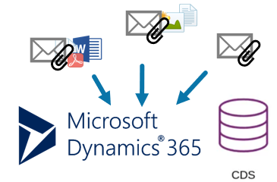
Save Money and Dynamics 365 Data Storage
No matter what industry or sector your company operates in, hundreds of emails are sent and received every day. On a monthly basis, this results in a considerable amount of data, which also takes up a lot of storage space. AttachmentExtractor helps you reduce the amount of data by up to 60% per day by extracting and moving attachments and notes to Azure Blob Storage or SharePoint.
CHALLENGES
OUR SOLUTION
DESIRED OUTCOMES
Expensive database space
High demand on storage space
Time intensive process to move files from Dynamics 365 to SharePoint
AttachmentExtractor saves money and Dynamics 365 data storage by moving e-mail attachments, notes and e-mail content to an alternative storage.
Save money by moving documents and e-mail content to an alternative storage (Azure Blob or SharePoint)
No difference in accessing extracted content for users
Speed up migrations & upgrades
Notes:
A lot of document s- it has to be simple. – non manual
Donations, PowerApps Portal integrations

Slide 3
Key Features
EXTRACT E-MAIL CONTENT
AZURE BLOB STORAGE
NO CHANGE IN DYNAMICS 365 UI
Save data capacity by moving e-mail content from Microsoft Dynamics 365 (Dataverse) to an alternative storage.
AttachmentExtractor supports Azure Blob Storage (ABS) for storing large amounts of documents as well as e-mail content.
The extraction process is fully transparent. Thus, users will not notice differences when accessing the extracted content.
EXTRACT E-MAIL ATTACHMENTS & NOTES
SHAREPOINT INTEGRATION
ARCHIVING
Save file capacity by extracting e-mail attachments or note content to either SharePoint or Azure Blob.
Fully integrated with SharePoint, e-mail attachments and notes can be automatically extracted to the correct document location. If a location is missing, our tool will create it for you.
AttachmentExtractor also allows to e.g. only move content that is older than 2 years.
And many more…
Notes:
A lot of document s- it has to be simple. – non manual
Donations, PowerApps Portal integrations

Slide 4
Dataverse Storage Model
Database Capacity
10 GB + 250 MB/user​^{*1}
Addon: $ 40/GB/month^{*2}
The Challenge:
E-mail content consuming data capacity
E-mail & note attachments consuming file capacity
Both are continuously growing in production environments
Result:
Additional expensive capacity add-ons are required
Attachments are hard to find in Dynamics 365
File Capacity
20 GB + 2 GB/user^{*1}
Addon: $ 2/GB/month^{*2}
Log Capacity
2 GB^{*1}
Addon: $ 10/GB/month^{*2}
¹⁾ https://dynamics.microsoft.com/en-us/pricing/ - Dynamics 365 Licensing Guide
²⁾ https://admin.microsoft.com/Adminportal – Purchase Services

Slide 5
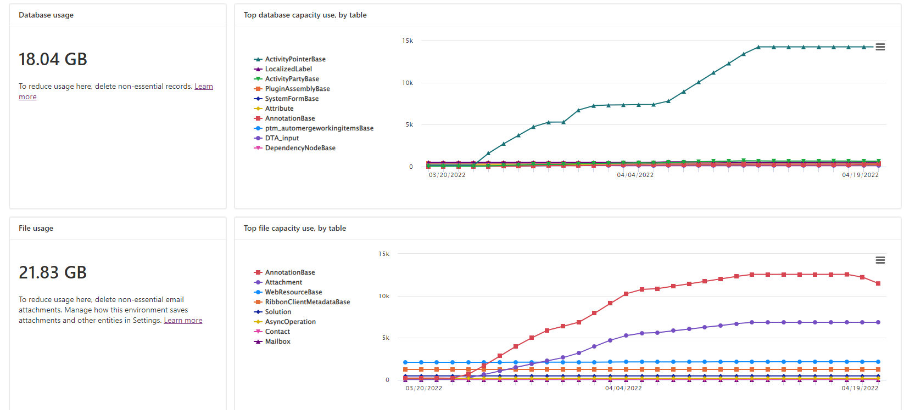
Capacity Consumption
Notes:
A lot of document s- it has to be simple. – non manual
Donations, PowerApps Portal integrations

Slide 6
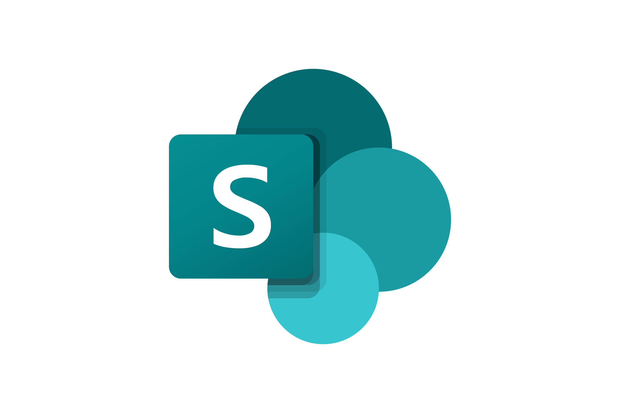
AttachmentExtractor
Dataverse Microsoft Dynamics 365 & Power Apps data
Key Benefits
Reduce data & file capacity and save costs
No change for your users on file access
SharePoint: Follow rules defined by Dynamics 365 integration
Build Archive or Backup
AttachmentExtractor
Azure Blob Storage
Email-content
File attachments
SharePoint Online
File attachments

Slide 7
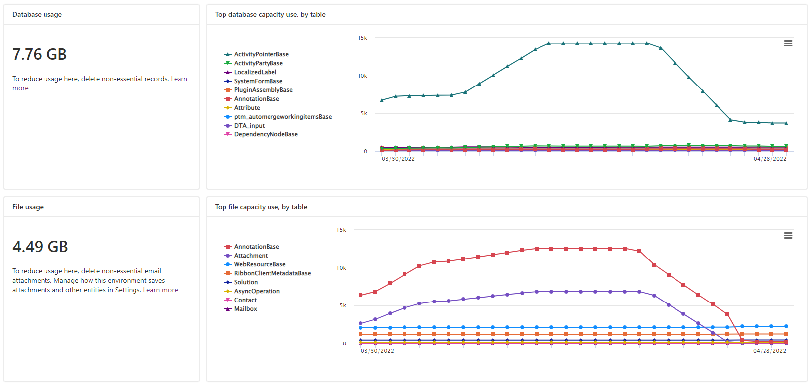
Capacity after Reduction
Email content service
-57%
Attachment service
- 79%
*Screenshot Taken 4/29/2022

Slide 8
Cost Savings Example
Type | 18th April (in GB) | 29th April (in GB) | Reduction (in GB) | Cost per GB (in USD) | Potential Savings (per month!)
Data capacity | 18.04 | 7.76 | 10.28 | $ 40.00 | $ 411.20
File capacity | 21.83 | 4.49 | 17.34 | $ 2.00 | $ 34.68
 |  |  | Total Savings: $ 5,350.56 per year |  | $ 5,350.56 per year
Type | Reduction Percentage
Database | 57%
File | 79%

Slide 9
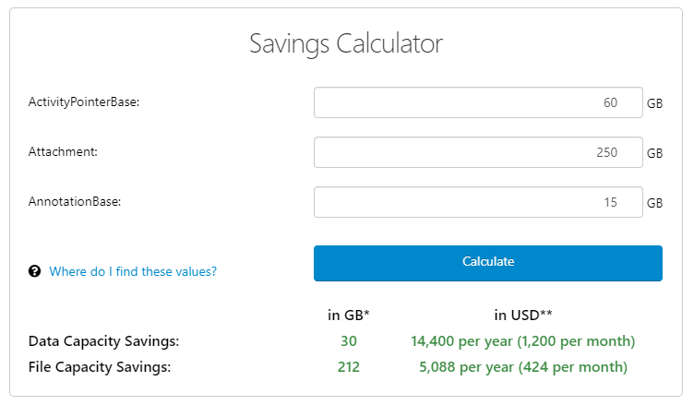
Savings Calculator: How much money can you save?
1. Provide your current table size
2. Hit „Calculate“
3. See your potential savings
Open Calculator

Slide 10
What our Customers say
„AttachmentExtractor is our go-to solution when a customer has files stored in Dynamics 365. It's simple to configure and monitor and provides a seamless solution to move big files to SharePoint.“
Heidi Neuhauser
“We were in need for a quick fix to make space in our Dynamics 365 data base and documents storage. The application is easy to install and to understand for a fairly reasonable price. A +++ for their customer service department.”
Melisa Berube
“AttachmentExtractor has truly brought down our database and file storage on the Dynamics 365. With the expensive database storage costs from Microsoft, this add-on is highly recommended”
Appsource Review

Slide 11
Customer Statistics and Benchmarks
Active customers: 500+
Enterprise (>1000): 16
Highest # of users: 4255
Highest utilization: ~2 TB extracted
Success Stories

Slide 12
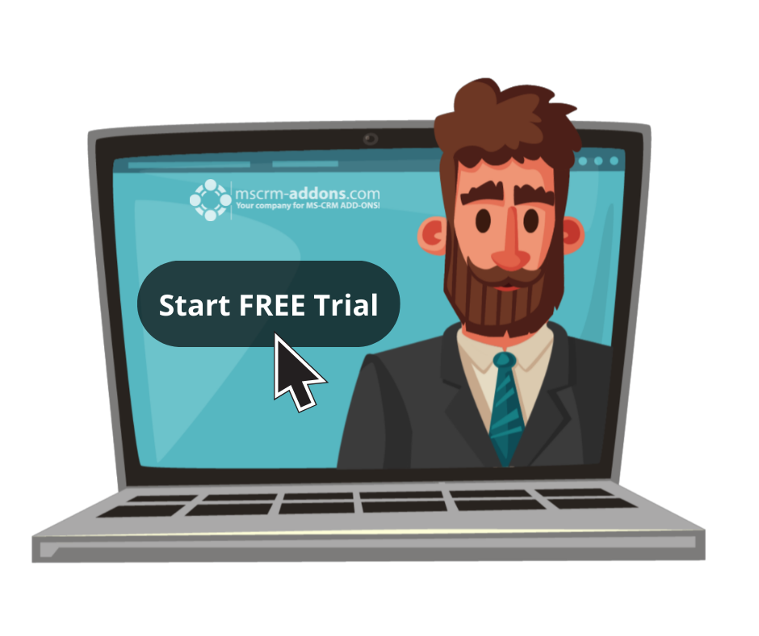
Free Trial
Free Trials Available for all Add-Ons
No functional limitations
Fully supported
~30 minutes to get started

Slide 13
Use Cases/Customer Success Stories
Spigraph
France, Spain, Portugal, Germany ...
ReEmployAbility Brandon, Florida
Challenge:
High storage costs
High demand for database space
Database space is expensive
Solution:
AttachmentExtractor saves money and Dynamics 365 data storage
Reduction of costs and database space
An outstanding level of support
Read Case Study
Challenge:
Demand of additional storage space
Reduce storage space costs
Database space is expensive
Solution:
AttachmentExtractor saves database space in Dynamics 365
Moves attachments to SharePoint/Azure Blob Storage
Indexing and search options
Solution works in the background
Read Case Study

Slide 14
Getting Started
Download & install AttachmentExtractor
Online: AppSource
On-Premise: http://www.mscrm-addons.com/Downloads.aspx
Getting Started with AttachmentExtractor for Dynamics 365 Online: Find AppSource installation steps here
On-Premise: Execute the downloaded msi-file on your local server or VM on Azure, where you want to host the AE service.
Setup the service
Step-by-Step video: https://support.mscrm-addons.com/knowledgebase/attachmentextractor-online-service-configuration/
Documentation: http://www.mscrm-addons.com/Support/Documentation.aspx#AE
That’s it! Our solution will run in trial mode for 14 days automatically The trial is limited to volume. Thus, you can only extract or copy 500 documents. If you need an extension for a customer, contact our support team and ask for a key!
Find more information here.
Mscrm-addons.com is fully supporting trials – If you have any questions, don’t hesitate to get in touch with our support team via
- Live-Chat (available 17 hours a day)
- E-mail to support@mscrm-addons.com

Slide 15
Getting Started
Download and Install AttachmentExtractor Download: AppSource Find AppSource installation steps here
Create a AttachementExtractor Service Step-by-Step video: Attachmentextractor Online Service Configuration
Documentation: http://www.mscrm-addons.com/Support/Documentation.aspx#AE
That’s it! Our solution will run in trial mode for 14 days automatically If you need an extension, simply contact your Partner Manager or our support team and ask for keys!
All trials are fully supported. Don’t hesitate to get in touch with our Support Team should you have any questions!
Note: for On-Premise Deployments see: Download Area

Slide 16
Pricing EUR
License model: Subscription
Support & Maintenance is included
The min. term of the contract is 1 year; billing is conducted yearly
Component | Annually | Bandwith in GB | Sandbox Environments incl.
XS (1 – 10 users) | € 690 | 2.5 GB | 1
S (11 – 30 users) | € 1.140 | 5 GB | 1
M (31 – 80 users) | € 1.650 | 10 GB | 2
L (81 – 140 users) | € 2.075 | 15 GB | 2
XL (141 – 300 users) | € 3.100 | 20 GB | 3
XXL (301 – 600 users) | € 5.450 | 25 GB | 5
Enterprise ( 600+ users) | On request

Slide 17
Pricing USD
License model: Subscription
Support & Maintenance is included
The min. term of the contract is 1 year; billing is conducted yearly
Component | Annually | Bandwith in GB | Sandbox Environments incl.
XS (1 – 10 users) | $ 825 | 2.5 GB | 1
S (11 – 30 users) | $ 1,500 | 5 GB | 1
M (31 – 80 users) | $ 2,030 | 10 GB | 2
L (81 – 140 users) | $ 2,640 | 15 GB | 2
XL (141 – 300 users) | $ 4,080 | 20 GB | 3
XXL (301 – 600 users) | $ 7,200 | 25 GB | 5
Enterprise ( 600+ users) | On request

Slide 18
Thank you!
www.mscrm-addons.com
support.mscrm-addons.com
Youtube Channel (How To's, Use-Cases)
info@mscrm-addons.com
EMEA: +43 316 680 880
U.S.: +1 404 720 6066

