Slide 1
SmartBar for Microsoft Dynamics 365 & Power Apps
www.mscrm-addons.com

Slide 2
Improve Navigation & Personalize your Dynamics 365 Forms
NAVIGATE
Add navigational buttons to your forms and dashboards
Persistent (Simple back and forth navigation)
Direct link to related records
NEW: Add buttons for certain views (E.g. unpaid invoices, open cases,…)
QUICK VIEW & COUNT
Count and display the number of related records
NEW: Color-code buttons based on count (E.g. red when more than 5 open cases)
NEW: Hide buttons if no records exist (count = 0)
CUSTOMIZE
Adopt SmartBar to your needs
Embed into any Dynamics form and dashboards
Delete, add and rearrange the "Buttons"-order
Switch between Standard or Metro style
Notes:
Another business problem we are providing a solution for is: Tracking of phone calls. One huge value of a CRM system is that all customer interaction is stored and can be reviewed in order to decide whats best next.
Unfortunately its quite a lot of clicks to e.g. Store a phone call (create, enter data, lookup contact/lead, regarding etc. )
Dialing: provide a simple methdo of initiating phone calls with contacts.
Power-dialing – telemarketing/inside sales teams etc.
So we aim to rpovide a single interface to many phone systems. On the right you can see some of the supported vendors. (old fashioned systems but, likewise to the market, we are seeing more demand for support of VOIP based systems like Skype for business or Ringcentral)

Slide 3
Key Features
USER FOCUSED INTERFACE
CUSTOMIZABLE BUTTONS
SIMPLE NAVIGATION IN DYNAMICS
Draws attention to the relevant information and showcases all related tasks, alerts, notes and other useful information about a data record.
Colored buttons directly show all associated data for an entity and can be customized to your requirements.
A simple back & forth navigation lets you comfortably switch information. Thanks to SmartBar's universal compatibility, it can be embedded in any Dynamics 365 form.
BUTTONS REPRESENT RELATED RECORDS
CONFIGURABLE VIEWS
COLOR CODING
A number next to the "Buttons" shows the number of related records per entity.
Display critical information like "Open Cases" or "Opportunities over 10K".
Change button color based on the count of related records.
And many more…
Notes:
A lot of document s- it has to be simple. – non manual
Donations, PowerApps Portal integrations

Slide 4
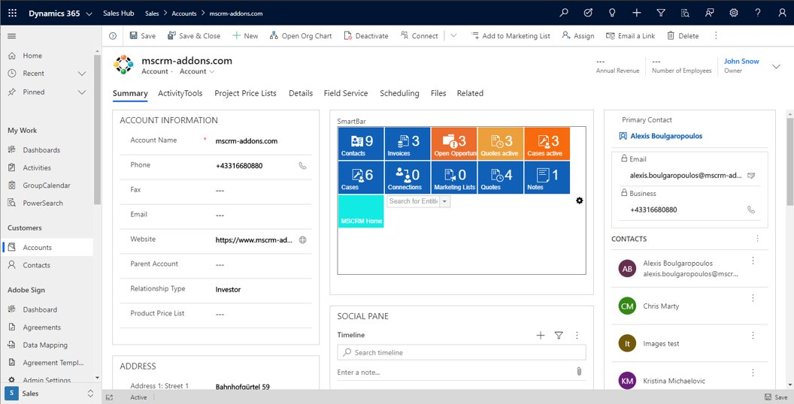
Simplified Navigation between Related Records
Key Benefits
Improved productivity
Quick access of related records
User adoption
Reduced clicks to access records
Immediate view on important items
SmartBar: Overview of related records
Back & forth navigation
Color-coding
Notes:
Company overview - ~1 min
- Locations (+US) – better support service
Gold partner + certified solutions
Speaker: 1 sentence –

Slide 5
Customer Statistics and Benchmarks
Active customers: 100+
SMB to Enterprise
Highest # of users: 2700
Success Stories

Slide 6
Use Cases/Customer Success Stories
SystemAir 1600 users, 49 countries
Challenge:
The Dynamics 365 intern search function
A lot of room for improvement
Missing functionalities
Solution:
The collaboration led to a totally new, innovative product PowerSearch
Combines the simplicity of standard search with the capabilities of Advanced Find
Improvement of the Dynamics 365-intern search function
Read Case Study
Notes:
A lot of document s- it has to be simple. – non manual
Donations, PowerApps Portal integrations

Slide 7
Free Trial
Free Trials Available for all Add-Ons
No functional limitations
Fully supported
~30 minutes to get started

Slide 8
Getting Started
Download and Install SmartBar Download: AppSource Find AppSource installation steps here
Info: https://www.mscrm-addons.com/Products/SmartBar
That’s it! Our solution will run in trial mode for 14 days automatically If you need an extension, simply contact your Partner Manager or our support team and ask for keys!
All trials are fully supported. Don’t hesitate to contact our Support Team should you have any questions!
- Live-Chat (available 17 hours a day)
- E-mail to support@mscrm-addons.com
Note: for On-Premise Deployments see: Download Area

Slide 9
Pricing EUR
License model: Subscription
Support & Maintenance is included
Component | Price /license monthly /annually | Support & Maintenance*
Per Site license (Must cover all active users) | € 1,60 / € 1,25 | Included

Slide 10
Pricing USD
License model: Subscription
Support & Maintenance is included
Component | Price /license monthly /annually | Support & Maintenance*
Per Site license (Must cover all active users) | $ 2.00 / $ 1.75 | Included

Slide 11
Thank you!
www.mscrm-addons.com
support.mscrm-addons.com
Youtube Channel (How To's, Use-Cases)
info@mscrm-addons.com
EMEA: +43 316 680 880
U.S.: +1 404 720 6066

